Slide 1
Framework versus Standard

Slide 2
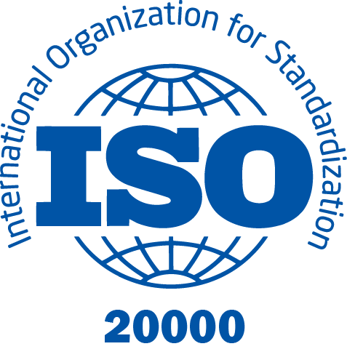
Standards
Mandatory requirements
Built on a specific topic
Can lead to certification

Slide 3

Frameworks
Guidelines that can be followed
Collections of best practices
Non-prescriptive
Must be customized when implemented

Slide 4
ITIL Is a Framework!

Slide 5

Some Key Advantages for Companies
Only individuals can achieve ITIL Certification
Organizations must apply for ISO 20000 certification
Treat “ITIL Certified” or “ITIL Compliant” solutions with caution
There is no single way to implement ITIL

Slide 6
About the Exam
Next Video

